Slide 1
AtliQ Hospitality Analysis
BY : K.R.POORNIMA

Slide 2
Problem Statement
Atliq Grands owns multiple five-star hotels across India. They have been in the hospitality
industry for the past 20 years. Due to strategic moves from other competitors and ineffective
decision-making in management, Atliq Grands are losing its market share and revenue in the
luxury/business hotels category. As a strategic move, the managing director of Atliq Grands
wanted to incorporate “Business and Data Intelligence” in order to regain their market share
and revenue.
However, they do not have an in-house data analytics team to provide them with these
insights. Their revenue management team had decided to hire a 3rd party service provider to
provide them with insights from their historical data.

Slide 3
Analysis to be performed:
●Filters by properties, city, status, platform, month and week.
●Revenue, Occupancy % and Average rating cards.
●Split by City, Property by key metrics.
●Trends by week, Occupancy by day type, Booking % by platform.

Slide 4
Database details
We are provided 3 moths booking details data of all the atliq hotels.
Dataset contains 5 excel files.
Dim_date
Dim_hotels
Dim_rooms
Fact_aggregated_bookings
Fact_bookings
Metric list excel file

Slide 5
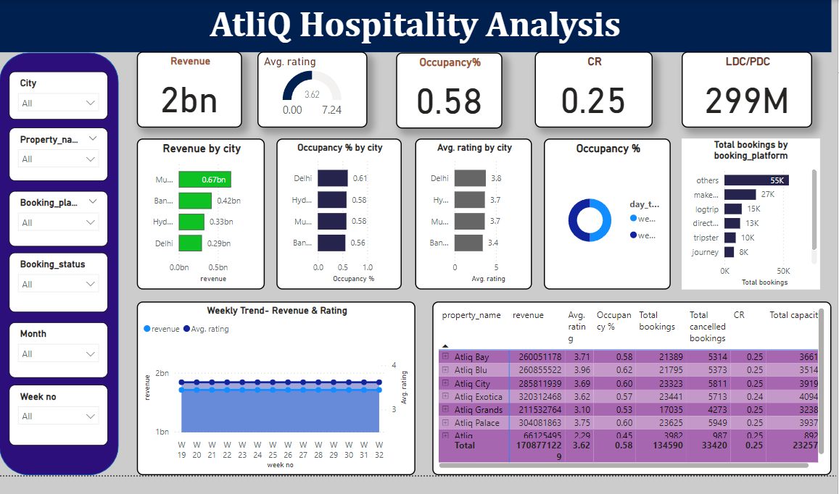
Analysis using power bi
Overall analysis

Slide 6
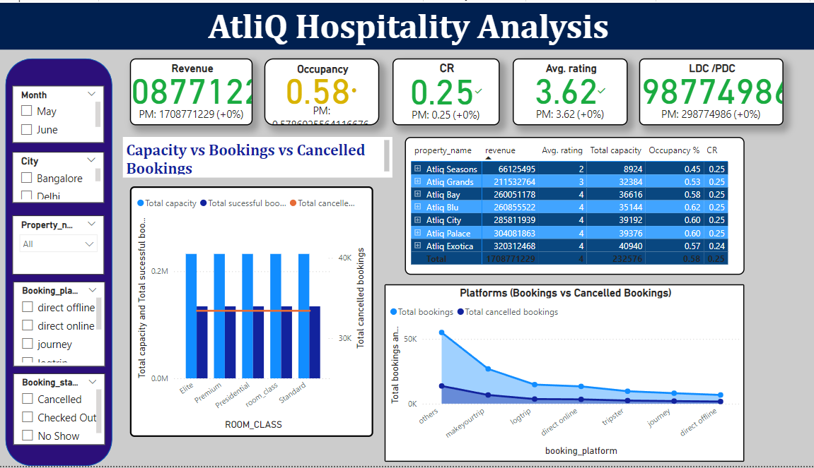
Month wise analysis

